Slide 1
Hi DARRAGH I WOULD LIKE TO KEEP THIS SIMPLE AND CLEAR – USE OUR NAME AND LOGO PROMINENTLY AND OUR UNDERSCORE – “CREATING HUMAN FIREWALLS “ OR “CREATING YOUR HUMAN FIREWALL” AND IF YOU CAN DEVELOP A CLEAR AND EXPLICIT GRAPHIC TO ILLUSTRATE THE HUMAN FIREWALL USE THAT WE NEED THIS TO BE CLEAR AS DAY – THEY HAVE TO TOTALLY GET IN THRU THE NEXT 2 SLIDES HUMANS ARE THE WEAKEST LINK
“Workplace Behaviour: Activating your greatest security asset”
Presented by: Stephen Burke
Founder and CEO
cyberriskaware.com

Slide 2
AGENDA
Who or What do Cyber Criminals Target?
What are most companies doing to defend the network?
What is the greatest security asset at our disposal?
How to “activate your greatest security asset”?

Slide 3
Quick show of hands …… Who agrees with the statement
Security Budgets are mostly being spent on technical defenses!

Slide 4
Quick show of hands …… Who agrees with the statement
Cyber Criminals Target People,
NOT system’s !

Slide 5
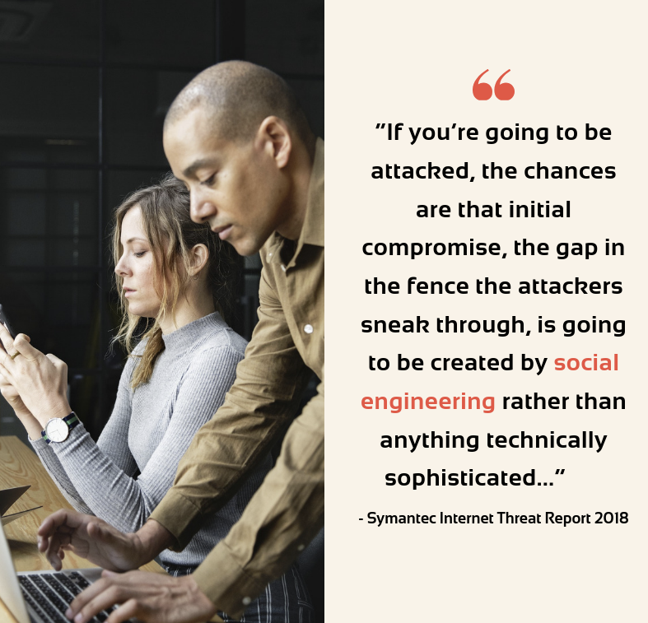
Cyber Criminals Are Targeting People !!

Slide 6
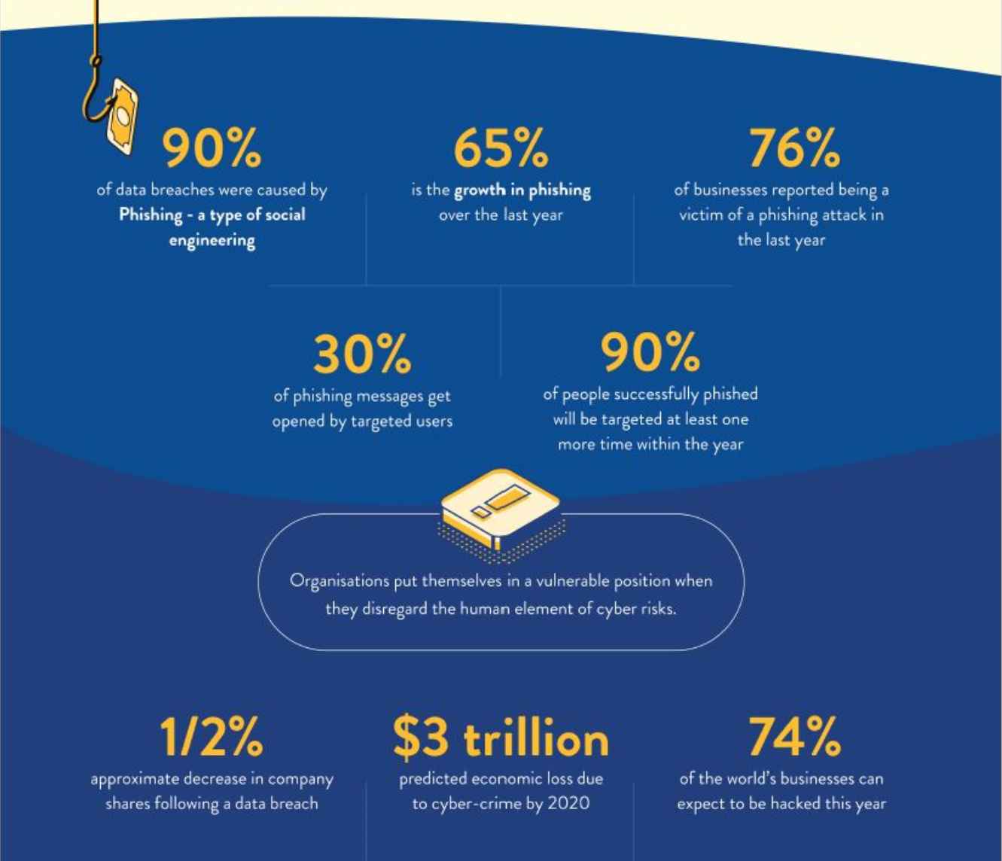
to great success …….. 99% of incidents had human involvement

Slide 7
The Compromised Insider
Malware victims
Impersonated users
The Malicious Insider
Rogues employees
Criminal actor employees
The Accidental Insider
Inadvertent actors
Convenience seekers
Insider Threats

Slide 8
Yet companies keep investing in Technical Defense’s…

Slide 9
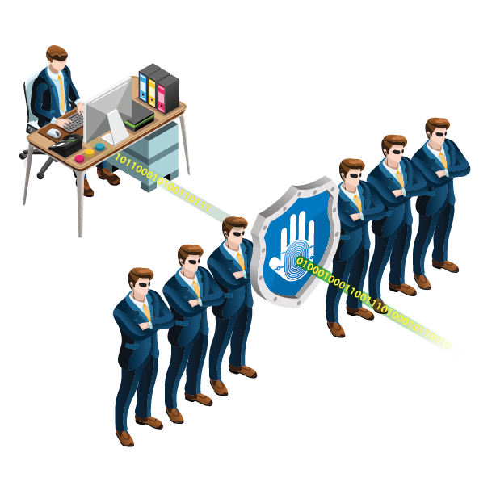
Our Greatest Security Asset is our ……. People
“Create a human firewall.
A network of human sensors.”

Slide 10
Workplace Behaviour Challenge
“Security Culture
is what employees do
when the security team
isn’t looking”

Slide 11
Common Workplace Behaviour(s)
Clicking on links and opening Email attachments
Reusing Passwords across accounts
Dept’s sharing accounts with passwords stored in XLS!
Password - Incrementing a number by 1 ☺ (Yes, we know!)
Downloading Free Software
Unsafe Web Browsing
Risks when traveling “Outside the Office”
Weak Data Protection Practices
Little to no understanding of Security Policies

Slide 12
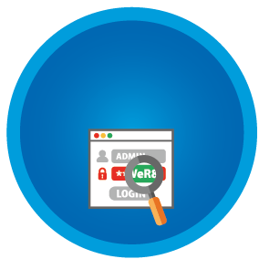
Activate Positive Behaviour Change
Security Awareness Program
Real-Time Delivery
Knowledge
Assessments
Compliance
& Risk
Reporting
“SMiShing”
Tests
Policy
Snippets
Phishing Tests
Real Time Intervention Awareness
TRAIN STAFF AT POINT of NEED
instead of just
scheduling content
Deliver fully contextualised content straight to staff based on exhibited risk behaviour.

Slide 13
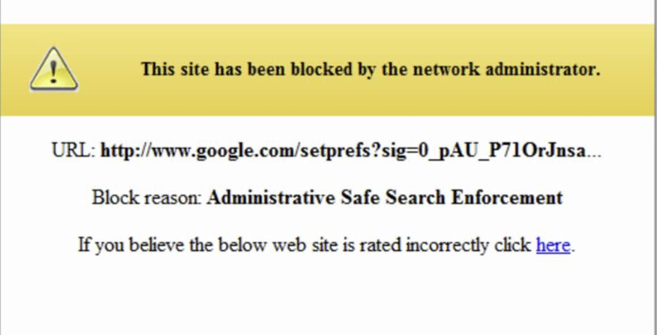
USER TRIES TO DOWNLOAD FREE SOFTWARE
What will the user do now ?

Slide 14
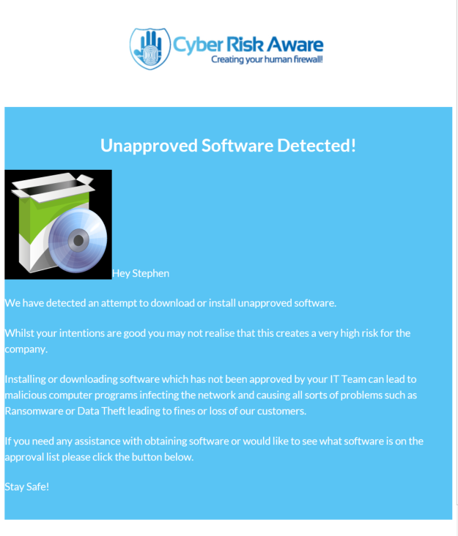
USER TRIES TO DOWNLOAD FREE SOFTWARE

Slide 15
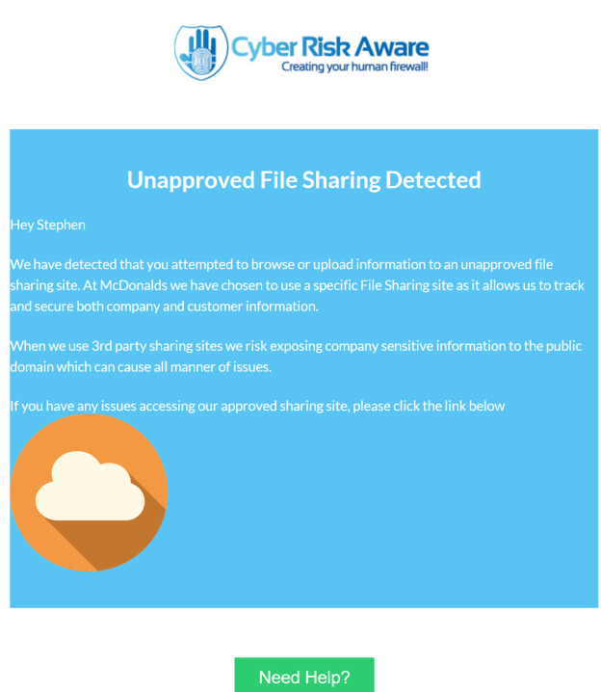
ACCESS SENSITIVE DATA THEN DROPBOX?

Slide 16
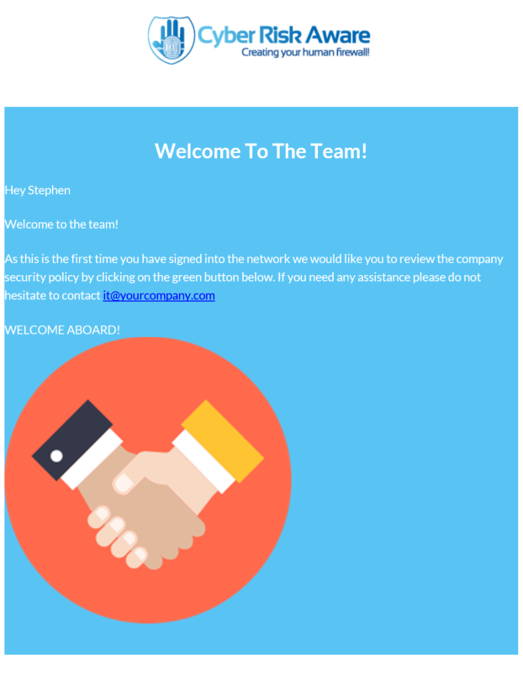
AUTOMATE STAFF ON-BOARDING

Slide 17
THANK YOU
For further information please contact:
Stephen Burke; Founder and CEO
E: stephen@cyberriskaware.com
T: +353-87-9583766
cyberriskaware.com

