Slide 1
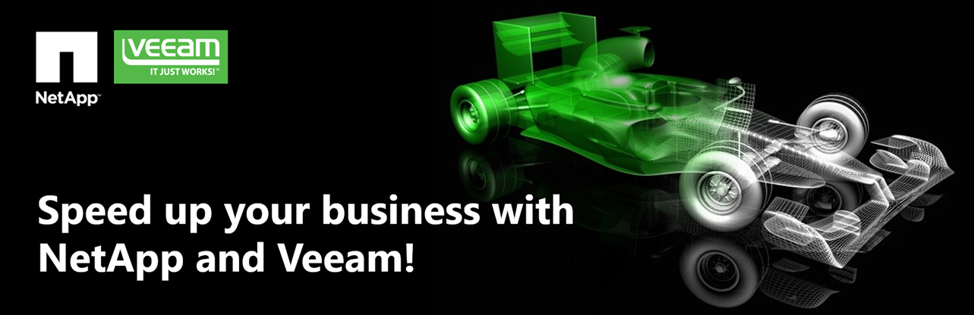







Veeam software
Risk Mitigation and Protection
Paul Szelesi, Solutions Architect North Western EMEA Veeam Software
Paul.Szelesi@veeam.com
+44 7545 627963

Slide 2
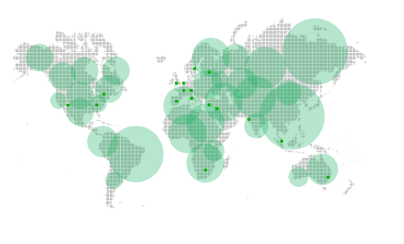
Welcome to Veeam
Veeam was founded in 2006
Headquarters in Baar, Switzerland
Global coverage
Number of customers
205,000
customers
worldwide
2,000+ employees worldwide
48%
of Global 2000
70%
of Fortune 500
11.8M VMs protected
are Veeam customers

Slide 3
Welcome to Veeam
Veeam recognises new challenges that companies across the globe face with data protection and risk mitigation.
Veeam Technology leverages virtualization, storage, and cloud technologies enabling the modern business to save time, mitigate risks, dramatically reduce capital and operational costs.
Veeam's aim is to support the current and future business goals of all Veeam customers.

Slide 4






Continuing Challenges Around Data Protection
Always-On™
High-speed recovery
Data loss Avoidance
Verified Protection
Leveraged Data
Complete visibility
Modern Data Center
Productivity

Slide 5

A New Way of Protecting Data
Bank Of Russia
Migration from traditional backup software to Veeam Availability Suite
Challenges
Data growth with exponential trends.
Complex Management
Data Compliancy and protection.
Not meeting SLAs on recovering data
Projects on hold because of lack of resources.
No confidence in backup integrity.
Legacy
Running short of capacity on storage.
Takes a long time to recover even a simple file.
Only 8 out of 10 backups can be recovered from tape
No encryption on single files.
Dedicated administrator specialising in backing up and recovering data.
Offsite is becoming unreliable.
Veeam Solution
Reduced data footprint with higher protection level.
Highest Encryption levels
Introduced Veeam technologies enhancing Restore & backup with better functionality.
Simplify administration, integrate into existing roles.
Introduce achievable SLA’s
Benefits
Reduced required storage capacity by 25%.
Reduced risk of data loss.
Encryption using industry standard levels for added protection end to end including FIPS compliancy.
Reduction in costs associated with data storage hardware.
Improved speed of restores.
Validation of backups ensuring all backups are functional and compliant.

Slide 6

1: The 3-2-1 Rule
2: Data encryption end to end
3: Multilevel role assignement
4: Right tool for the right job
5: Keep end users out of reach
Veeam Best Practice for Risk Mitigation
#1 Basic Veeam Data Best Practice for Data Protection

Slide 7
Veeam Best Practice for Risk Mitigation
#2 General Data Protection Regulations How will Veeam help?
Data Portability.
Simple movement of data from one place to another securely in single container.
Sensitive Data Protection
        Encryption algorithms using top level protocols (FIPS Compliant) protect data.
The Right To Be Forgotten
        Simple E-Discovery tools for data collection and erasure for even the smallest amount of data.
Cloud Control
      With an increasing number of cloud service providers using Veeam one product makes compliance simple and efficient in its protection of data.

Slide 8
All Part Of The Plan
Data protection is crucial to any organisations ability to survive.
90% of companies without a data protection strategy go out of business with two years following a major problem.
It's not a feature or add in, it's part of your infrastructure.
It's not about backup, that’s only the start.
You only realise how well your protected when you find you're not.

Slide 9
Customers are our R&D (Futures)
v8
V9.5
Linux Agents
Advanced storage integrations (NetApp)
Veeam Cloud Connect
Veeam Explorer for SQL Server
Veeam Explorer for Active Directory
Encryption (AES 256)
Backup I/O control
Snapshot Hunter
Server 2016 support
Advanced storage integrations (Nimble)
Direct Restore to Azure
Vmware Vcloud Director enhanced support
Sandbox from Storage Snapshots
20% speed increase for backups
Speed Enhancements for transformations.
Support for Physical Microsoft server backups to Veeam Repositories
Encryption
Agents to create Application Aware Backups
Q2 15
Q3/4 15
Q4/4 16
Q4/4 16
Q3/4 17
Q4 14
v8 Update 2b
v9
Q4/4 16
Windows Agents
Office365 Protection
vSphere 6 Support
vCD 5.6 Support
VVOL Support
vSAN2.0 + SPBM + FT VMs Support
Support for newest Linux technologies
Veeam Endpoint Backup Support
Scale out Backup Repository SoBR
Advanced storage integrations (EMC)
Veeam Explorer for Oracle
Veeam Cloud Connect Replica
Native NFS Client
Backup from NetApp SnapVault/SnapMirror
BitLooker
OnDemand Sandbox for Storage SnapShots
Support for Physical Microsoft server backups to Veeam Repositories
Encryption
Agents to create Application Aware Backups
Support for Physical Microsoft server backups to Veeam Repositories
E-Discovery on cloud provider locations
Agents to create Application Aware Backups

Slide 10







































Official References
Notes:
Kurz

Slide 11


Thank you

