Slide 1
Data protection headaches: GDPR, brexit AND perimeter risk
Date 20TH September 2016
Name NICK GIBBONS
Position, PARTNER BLM
T: 0207 457 3567
E: Nick.Gibbons@blmlaw.com

Slide 2
BUSINESSES IN THE UK ARE FACED WITH A GROWING HEADACHE IN RELATION TO DATA PROTECTION:
Cyber crime is now a daily reality
Although significant numbers of businesses have taken steps to address internal security, perimeter risk is a different problem
GDPR will make significant changes to data protection law but to what extent will it be affected by Brexit?

Slide 3
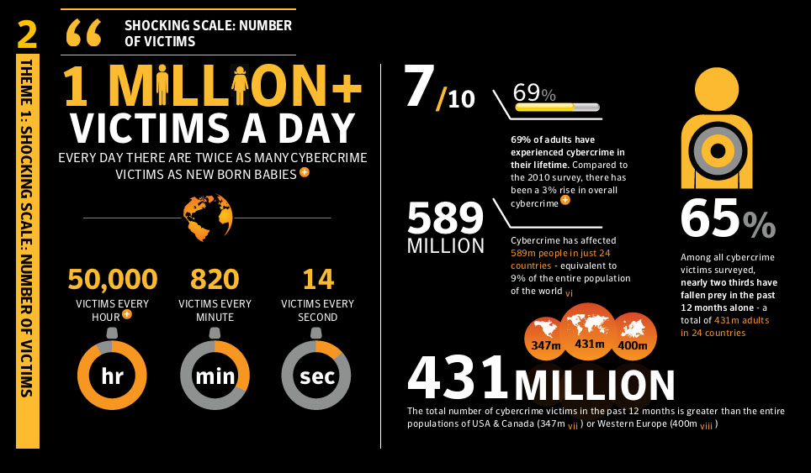
Cyber crime is now a daily reality
Cyber security now at the top of the agenda in many business
Cyber attacks are now a virtual constant for large companies.
Symantec estimates more than half a billion personal records were lost or stolen in 2015.
Off-the-shelf criminal software is now widely available on the dark web.
A study by cyber security firm FireEye found more than half (54%) of consumers in US felt more negatively towards companies that had suffered data breaches.

Slide 4
PERIMETER RISK
DPA Principle 7
Appropriate technical and organisational measures shall be taken against unauthorised or unlawful processing of personal data and against accidental loss or destruction of, or damage to, personal data.

Slide 5
A BUSINESS’ LEGAL RESPONSIBILITIES FOR DATA BELONGING TO THIRD PARTIES
Nearly all businesses will have not only their own data on their computer network but that of:
Customers;
Business partners;
Suppliers;
Employees.
They have legal obligations to all of them to protect that data.

Slide 6
BUSINESSES’ LEGAL RESPONSIBILITIES FOR ENSURING SAFETY OF DATA SHARED WITH THIRD PARTIES

Slide 7
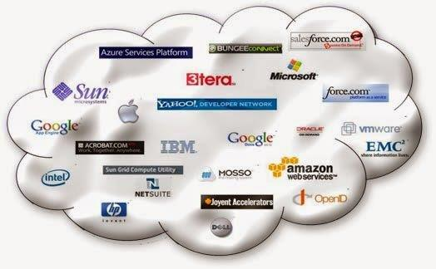
Cloud service providers/webhosting
DPA Schedule 1 Part II :
“the data processor will comply with security obligations equivalent to those imposed on the data controller itself.”
ICO Guidance:
“When processing is undertaken by a data processor, the data controller must choose a processor providing sufficient guarantees about the technical and organisational security measures governing the processing to be carried out, and must take reasonable steps to ensure compliance with those measures.”

Slide 8
Sharing data with other organisations: security issues
ICO GUIDANCE:
“make sure that it will continue to be protected with adequate security by any other organisations that will have access to it…..
…take reasonable steps to ensure that those security measures are in place, particularly by ensuring that an agreed set of security standards has been signed up to by all the parties involved in a data sharing agreement…..
…the organisations the data is disclosed to will take on their own legal responsibilities in respect of the data, including its security.

Slide 9
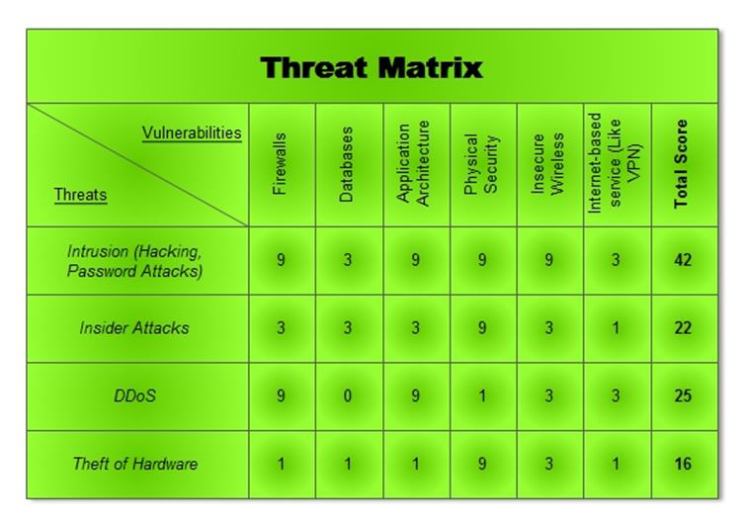
Cyber risk management
Has the business:
Implemented organisational and physical cyber security measures in addition to technical cyber security?
Identified key cyber exposures and the types of information that it holds on computers?
Appointed a cyber risk manager and allocated management responsibility for digital risks within the organisation?
Implemented a written cyber security policy that has the backing of the board and senior management and is enforced through regular staff training and monitoring?
Developed a cyber incident risk management plan for each type of incident which includes access to external incident response services?
Checked the cyber security of the company’s suppliers, service providers, business partners and professional advisers?
Accurately predicted what the impact would be on the company of each type of cyber incident?

Slide 10
General Data Protection Regulations 2016 KEY CHANGES
Requirement to notify breaches
Much tougher fines
Extra-territorial applicability
Application to both processors and controllers
One Stop Shop – lead supervisory authorities
Abolition of requirement to register as a data controller
Processing children’s data
European Data Protection Board
Right to be forgotten
Easier access to one’s own data
Right of data portability

Slide 11
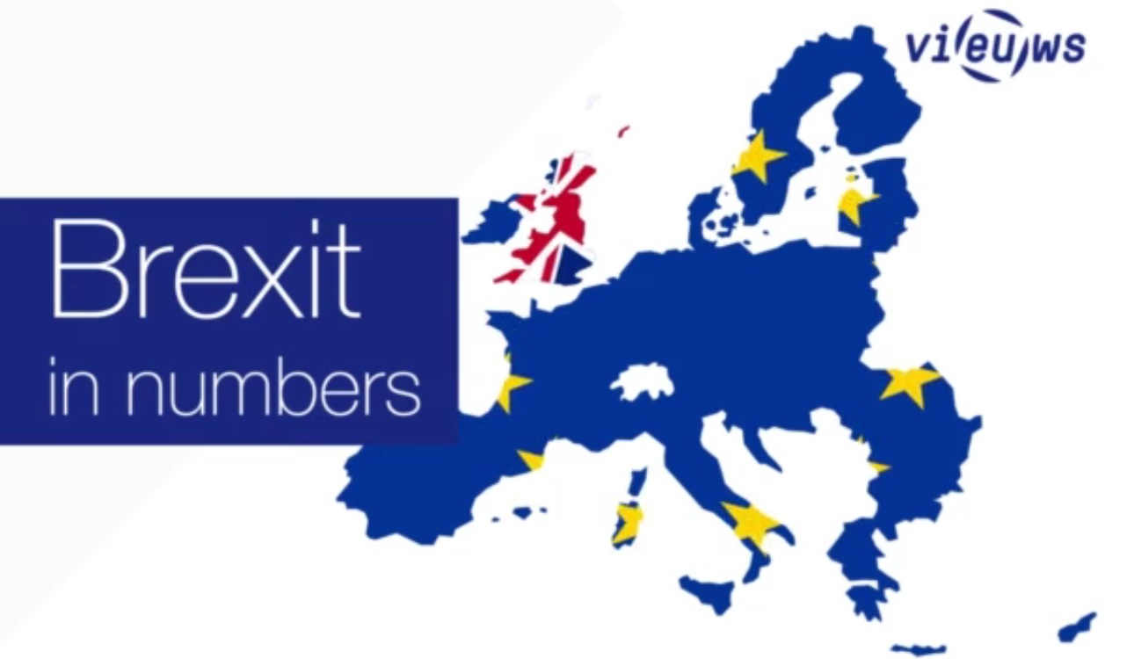
To what extent will the Brexit vote affect data protection law?
Article 50 of Lisbon Treaty
Timing
GDPR’s “long arm”
UK Post Brexit options and adequacy
EFTA and the Swiss model
Going it alone
Impact of Brexit on ICO

