Slide 1
Insurance Technology Forums: ‘IT Matters’ Forum
Cyber Insurance Market Update

Slide 2
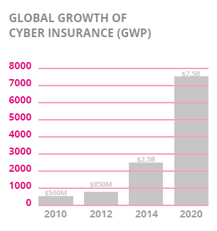
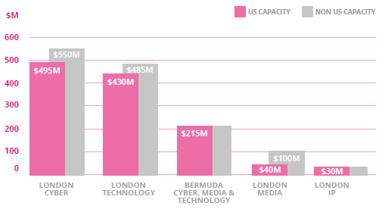
Cyber Insurance Market Update
Market growing
Demand increases internationally for cover, limits and different exposures
New MGA’s and Syndicates entering the market
Graph Source: London market estimates

Slide 3
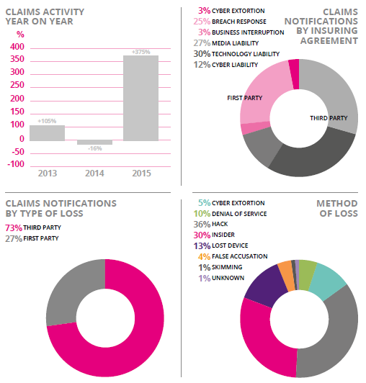
Cyber Insurance Claims Update
Increase in claims year on year
More 1st party notifications, however liability payments tend to be larger for the non-privacy elements of the policy
Causes of loss trends:
2014 – Lost Devices
2015 – Hacking
2016 – Ransomware
Graph Source: Paragon Claims Data

Slide 4
Cyber Insurance Rate Update
Rates remain relatively flat throughout all industries
Technology companies that aggregate data where the exposure significantly outweighs the revenue are still difficult to place
Strong Info Sec has become a license to buy
Underwriters will give a discount for good risks

Slide 5
Top 3 Ways In Which Cyber Insurance Can Support Companies In Regards To The GDPR
1. Fines - Up to EUR 20m or 4% of annual global turnover for breaches of the rules
Coverage Module - Privacy Regulatory Defence and Penalties
Insurability of fines
Defence and appeal costs
Consumer redress funds and class actions

Slide 6
Top 3 Ways In Which Cyber Insurance Can Support Companies In Regards To The GDPR
2. Breach notification:
Regulator - “without undue delay” and where feasible within 72 hours.
Affected Individuals – only where breaches likely to pose a high risk.
Coverage Module – Crisis Management Response Costs
Breach response hotlines
Over notification / correctly managing the response to avoid fines

Slide 7
Top 3 Ways In Which Cyber Insurance Can Support Companies In Regards To The GDPR
3. Supply chain - joint and several liability for suppliers (data processors).
Coverage Module – Privacy Liability
Can’t outsourcer your responsibility – still need to react to the breach

Slide 8
What Are Insurers Looking Looking For When Underwriting Risks?
Adequate Info Sec for your risk exposure
E.g. portable media encryption & multifactor external login
Employee training
Social Engineering
Outsource management
Vetting / auditing / access management
Tested Incident Response Plan
Brexit or not, insurers are looking for strong policies and procedures in place to avoid data breaches and to mitigate their effects.

