Slide 1
THE GROWING IMPORTANCE OF CYBER
RESILIENCE IN FINANCIAL SERVICES
January 2022
Start
Bringing Ingenuity to Life
paconsulting.com

Slide 2
Adapt or die
Pace of change
Regulation
Increasing complexity
“…in this new era of perpetual change that we’re living in, two years might as well be a lifetime…”
2

Slide 3
“The pace of change has never been this fast before, but it will never be this slow again”
I expect some prominent companies in financial services to fail because they are unable to keep pace with change
66%
Financial services firms that believe the cycle of innovation is speeding up
68%
76%
Companies ability to respond rapidly to change will make the difference between success and failure

Slide 4
The impact of COVID-19
BEHAVIOURS & EXPECTATIONS
STREAMLINING & SAFETY
SOCIAL VALUE & INNOVATION
01
Customer and service user behaviours and needs are changing
Relationships with partners, communities and regulators are shifting
03
Huge pressure to do more (much) with less, due to budget cuts or trying to survive continuous lockdown cycles
05
Climate change is creating the requirement to make a green recovery, with more planet-friendly sustainable business models, e.g. circular economy
02
Both what we need from current and future employees, and what they expect from work, has changed
04
Increased risks of security breaches due to remote working
Safety has taken on a new meaning in all aspects of the business
06
Opportunity to capitalise on emerging technology to not only survive 2021, but become a market leader

Slide 5

A re-cap – resilience as an industry priority
June 2018
Sewing the seed
2018 - 2021
Consultation and policy
2021, 2022 and beyond:
Making it happen
The Financial Policy Committee wants to set impact tolerances for cyber disruption and ‘test’ the ability of firms to meet these tolerances.
(BoE, PRA, FCA) on Operational Resilience
The papers set out how firms must identify their Important Business Services (IBSs)
Boards should assume disruption will occur and plan for it.
+Lloyds Bulletin Y5277 Jan 2020
+CBEST
+SS2/21 on Outsourcing
SMCR: SMF24 – it’s
the accountability of the Chief Operations Senior Manager to ensure Operational & Cyber Resilience
Operational Resilience Policy Published by the FCA and PRA. Implementation by March 2022 for first phase
It also makes clear that:
‘firms have primary responsibility for their ability to resist and recover from cyber incidents’.
5

Slide 6
The increasing complexity of the attack surface
Notes:
System modelling based upon the OSI-Model
Open Systems Interconnection model - The OSI Model was designed in 1977 and is part of the ISO specifications since 1984.
Each OSI layer serves a unique task for network communication.
1 – Application - Provide a user interface for sending and receiving data
2 – Presentation - Encrypt, format, and compress data for transmission
3 – Session - Initiate and terminate a session with the remote system
4 – Transport - Break the data stream into smaller segments and provide reliable and unreliable data delivery
5 – Network - Provide logical addressing
6 – Data Link - Prepare data for transmission
7 – Physical layer - Move data between devices

Slide 7
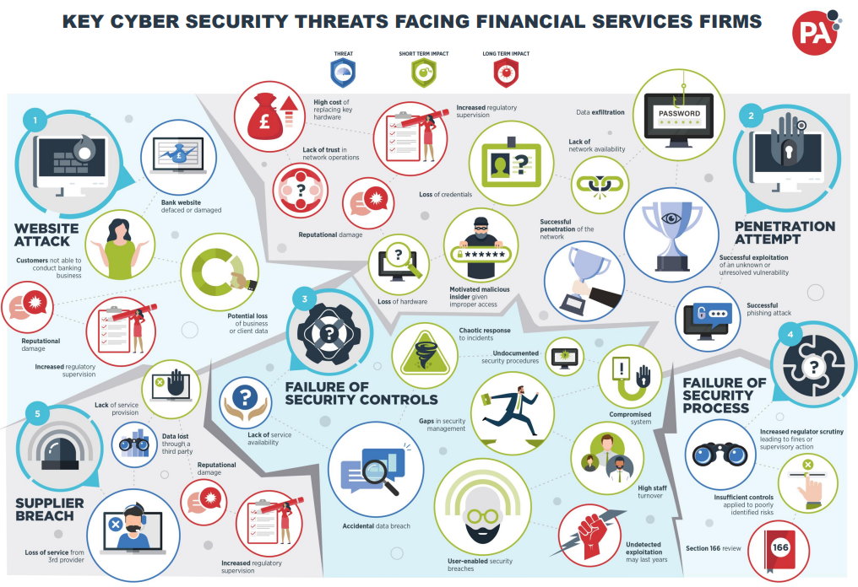
The increasing complexity of the threat landscape

Slide 8


The Chief Information Security Officer’s dilemma
…daily balancing act
DO THE BASICS WELL & SECURE BY DESIGN
1.
FIGHT FOR THE BEST PEOPLE
2.
PREPARE FOR THE WORST
3.
AUTOMATE
4.

Slide 9
1. DO THE BASICS WELL
…especially if you are moving workload to the cloud

Slide 10

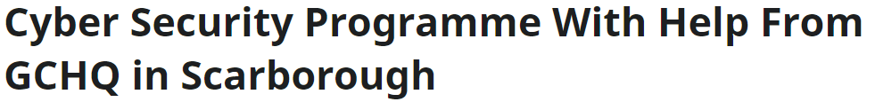
2. FIGHT FOR THE BEST PEOPLE
And consider alternative routes to cyber skills
Globally we have been short of cyber skills by about 40% for several years (according to the Department of Digital, Culture, Media and Sport and others).
This indicates that we are looking at a ‘lagging’ skills market and will always be short of scarce skills as the demand for digital and cyber skills grows. So, we need to look in non-traditional pools and train people to generate scarce cyber skills in 2022.
Alternative routes to cyber skills have looked at aptitude, curiosity, persistence and natural interest in cyber and digital.
        The results were astounding; drawing from a wide pool of people who hadn’t worked in cyber or STEM before - ranging from firefighters to chefs to beauticians - several hundred candidates were considered for 29 places, leading to 25 still in technical cyber jobs three years later.
    As will de-mystifying cyber and making it more relevant and accessible to the workforce as a whole. 2022 needs to be the year of using remote working to make cyber security a key enabler to organisations meeting their business objectives.

Slide 11
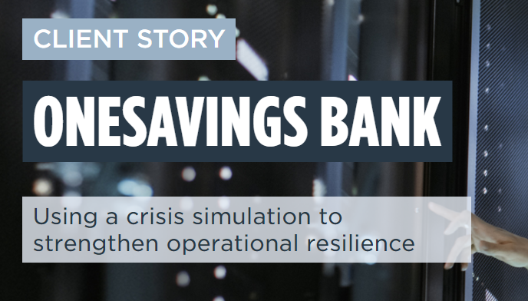
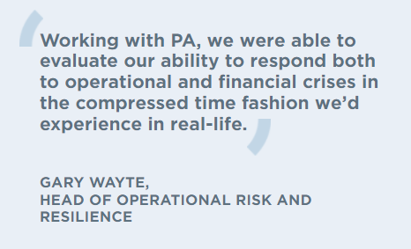
3. PREPARE FOR THE WORST
Simulation and exercising is a hugely undervalued technique

Slide 12
4. AUTOMATE
..and liberate your technical teams

Slide 13
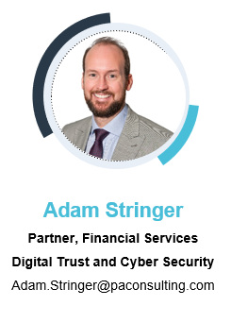
Thank you…

